Slide 1
Inductive voltage transformer
Group 3
Anubhav sabharwal
Mario Zaja
Matei OpRea
Volodymyr Myagkov
Riccardo carollo
David Martinez perez
2013
Coordinator:
Claus Leth Bak

Slide 2

Summary
1. Description of voltage transformer
2. Transfer ratio
3. Lightning overvoltage
4. Dielectric loss angle
5. Partial discharge
6. Dielectric spectroscopy
7. Conclusions

Slide 3
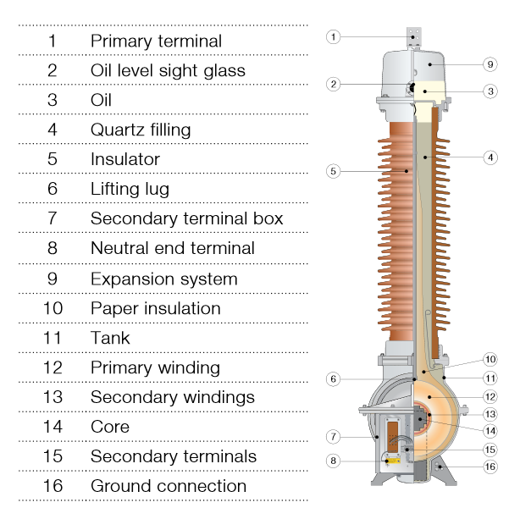
1.Description of the ABB inductive voltage transformer, rated data and dielectric design
ABB Switchgear |  | Nr 8350834
High voltage transformer |  | Type EMF 72
Insulation level 140-350kV |  | Highest Voltage for equipment 72.5kV 50Hz
Standard IEC 186 |  | Voltage factor (Vf) 1.9/8hrs
Total mass 190kg |  | Year 1998
A-N | 1a-1n | 2a-2n | da-dn
60000V/√3 | 110/√3 | 110/√3 | 110/√3 | V
Load | 1-15 | 1-65 | 75 | VA
Class | 0.2 | 0.2 | 3P
abb.com

Slide 4
1.Description of the ABB inductive voltage transformer, rated data and dielectric design
Good transformer:
Long Service life
Capable to withstand very high voltage stress
Lightning overvoltage (External)
Switching overvoltage (Internal)
Response of the insulation upon voltage stresses
Operate in all climatic conditions
Tests and measurements:
measure transfer ratio full range
power frequency and lightning overvoltage
dielectric loss angle
partial discharge measurement
dielectric spectroscopy

Slide 5


Transfer ratio full range
Definition:
Turns ratio:

Slide 6

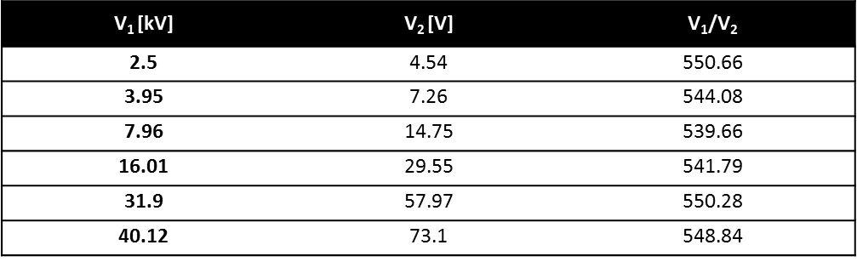
Transfer ratio full range
Theoretical:
Measured:

Slide 7
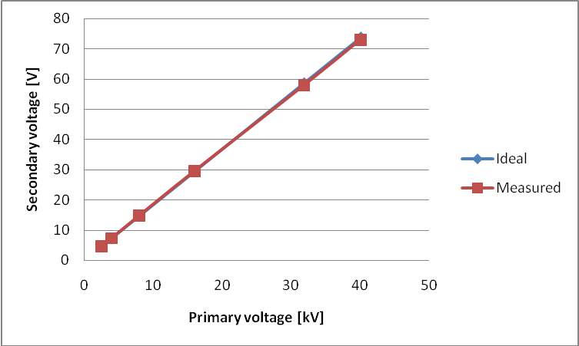
Transfer ratio full range

Slide 8
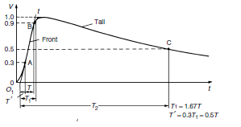
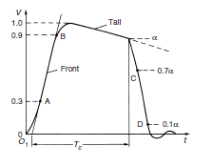
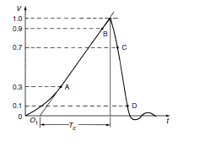
Lightning overvoltage
“Disturbances of electric power transmission and distribution systems are frequently caused by transient voltages whose amplitudes may greatly exceed the peak values of the normal a.c. operating voltage”.
Lightning overvoltages: originated by lightning strokes hitting the phase wires of overhead lines; Amplitudes very high compared to the rated voltage; More than100 kA into the transmission line; Too high voltage levels are immediately chopped by the breakdown of the insulation; Stress to the power equipments.

Slide 9
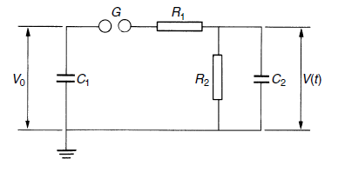
Impulse generator and test setup

Slide 10
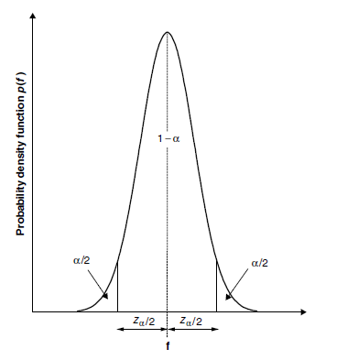

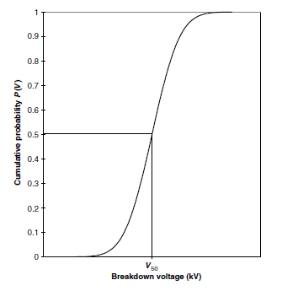
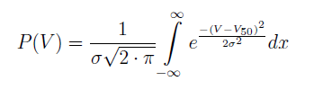
Results – what to expect
The most commonly used distribution function is the normal (Gaussian) Distribution
When the applied voltage V becomes the variable
V50 is the voltage which leads to 50% probability of discharge.
Knowledge of V50 allows us to calculate the value of the probability of discharge for any applied voltage.

Slide 11
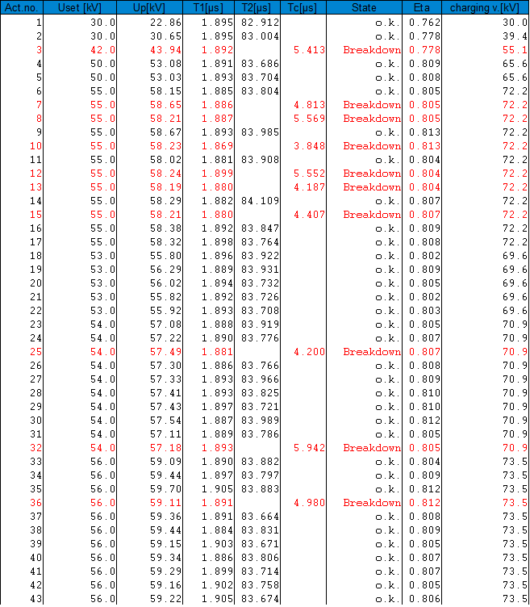
Our results and conclusion
A statistic distribution of the breakdown probability can not be provided with those data.
The reason for this behaviour can be found in the different test conditions occurred during the test measurements.

Slide 12
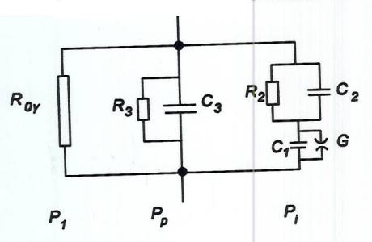
Dielectric loss angle
When an electric field is applied to a dielectric, several losses are induced:
Conductive losses (P1)
Polarization losses (Pp)
Ionisation losses (Pi)

Slide 13
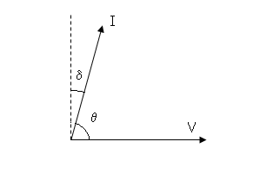


Dielectric loss angle
The dielectric loss angle is an AC non destructive HV method to measure all these losses.
tan δ is measured, which is the ratio between the total losses and the reactive power:

Slide 14
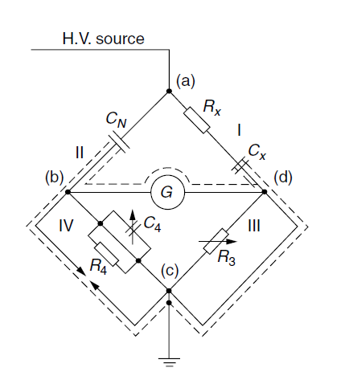

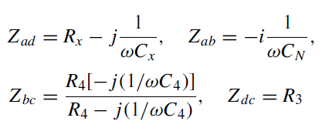
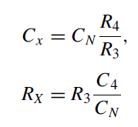

Dielectric loss angle
Schering bridge is applied:

Slide 15
Dielectric loss angle
Results:
Transformer Capacitor
U(kV) | tan(δ) | Cx(pF) | δ(º) | 90-δ
0,00 | 0,63 | 34,39 | 32,21 | 57,79
5,00 | 0,24 | 57,39 | 13,28 | 76,72
10,00 | 0,07 | 75,74 | 3,84 | 86,16
15,00 | 0,00 | 83,54 | 0,04 | 89,96
20,00 | -0,04 | 87,18 | -2,10 | 92,10
25,00 | -0,06 | 88,47 | -3,40 | 93,40
30,00 | -0,07 | 88,34 | -4,19 | 94,19
35,00 | -0,08 | 86,27 | -4,49 | 94,49
40,00 | -0,07 | 81,02 | -3,82 | 93,82
45,00 | -0,01 | 69,35 | -0,51 | 90,51
U(kV) | tan(δ) | Cx(pF) | δ(º) | 90-δ
0,00 | 0,02 | 20,02 | 1,23 | 88,77
5,00 | 0,02 | 20,02 | 1,25 | 88,75
10,00 | 0,02 | 20,03 | 1,29 | 88,71
15,00 | 0,02 | 20,04 | 1,34 | 88,66
20,00 | 0,02 | 20,05 | 1,38 | 88,62

Slide 16
Dielectric loss angle
Conclusions:
Capacitor presents constant values for tan(δ) and Cx and the transformer doesn’t.
Between 15-20kV the sign of the tan(δ) for the transformer changes.
For most part of the voltages measured the capacitor has smaller tan(δ) values than the transformer.

Slide 17
What is Partial Discharge ??
Localized electrical discharge that partially bridges the insulation between conductors and which may or may not occur adjacent to a conductor.
Or
It is a consequence of local electrical stress concentrations in the insulation or on the surface of the insulation. Pulses are of duration of less than 1µs.

Slide 18
Partial Discharge
Corona: It is a form of partial discharge that occurs in gaseous media around conductors which are remote from solid or liquid insulation.
PD includes the following discharge phenomena:
Internal discharges occurring within solid and liquid dielectrics.
Surfaces discharges appearing at boundary of insulation materials.
Corona discharges occurring in gaseous dielectrics.
Discharge channels formed by continuous impact of discharges in solid dielectrics.

Slide 19
Partial Discharge
The detection and measurements of discharges is based on the energy exchange.
Exchanges can be listed as:
Electrical pulse currents
Dielectric losses
E.M. Radiation
Noise
Increased gas pressure
Chemical Reactions

Slide 20
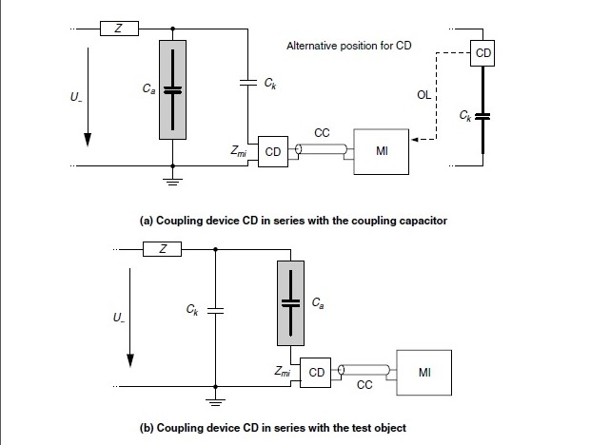
PD measuring systems within the PD test circuit
Partial Discharge

Slide 21
Partial Discharge
Some essential requirements and explanations
Coupling capacitor shall be of low inductance design and should exhibit low partial discharge.
Low background noise to allow the specified partial discharge to be measured at the specified test voltage.
Impedance may be introduced at high voltage to reduce back ground noise.

Slide 22
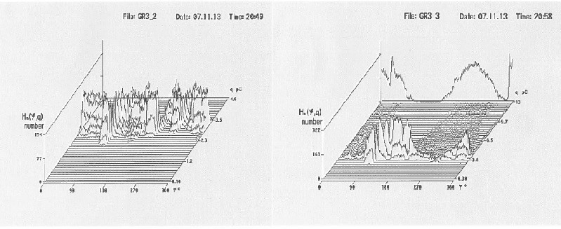
Measurements : Tests were performed at 15,20,24,25,45kV For Transformer at 45/24kv For Capacitor at 20kv
Partial Discharge

Slide 23
Conclusion
For transformer at 45 kV it is not clear where the discharge actually takes place and whereas for the home made capacitor at 20 kV most of the discharge takes place between 90 to 180 degrees.

Slide 24
6.Dielectric Spectroscopy
A non destructive method for assessing the insulation state
The dielectric insulation properties will be tested through a frequency sweep from 1 kHz to 0.0001 Hz, searching a time frequency response
The response (dissipation factor-tanδ) can be used to evaluate the state of the dielectric insulator and the coil geometry
The goal is to determine the aging and moisture of the transformer

Slide 25
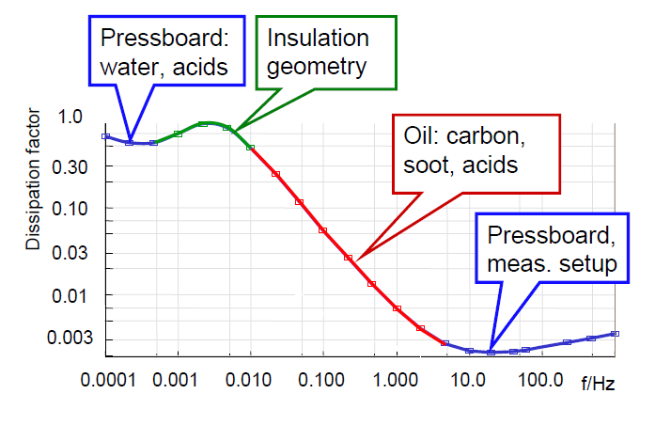
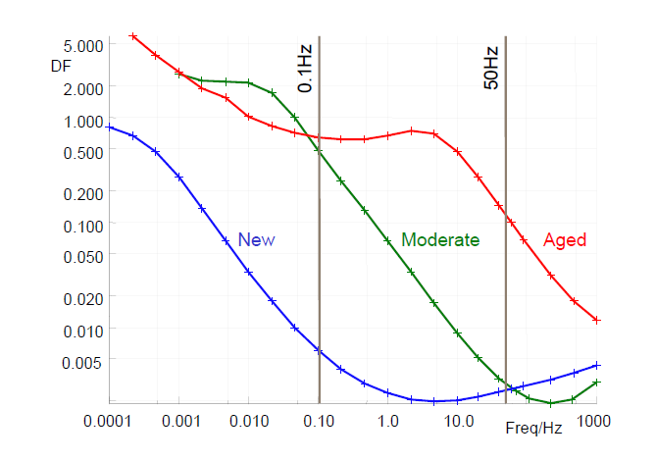
6.Dielectric Spectroscopy

Slide 26
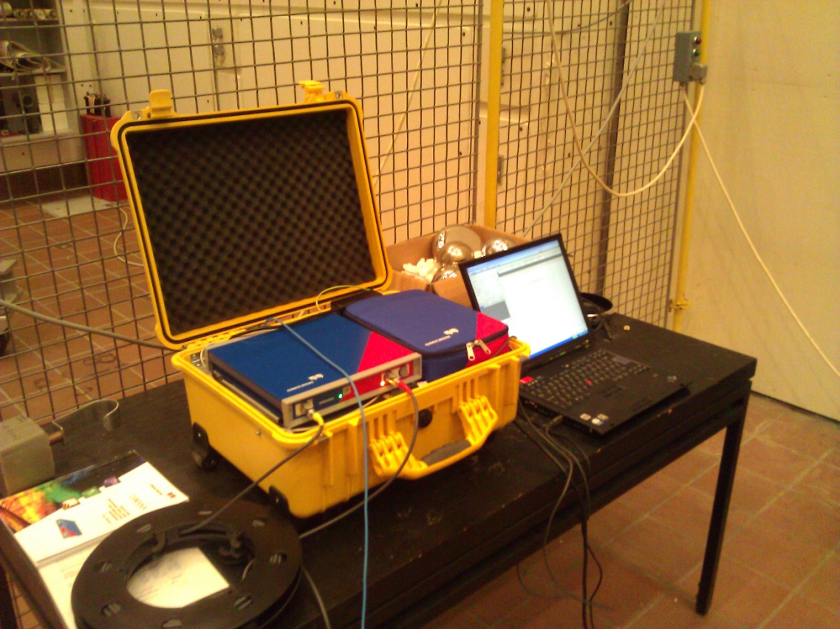
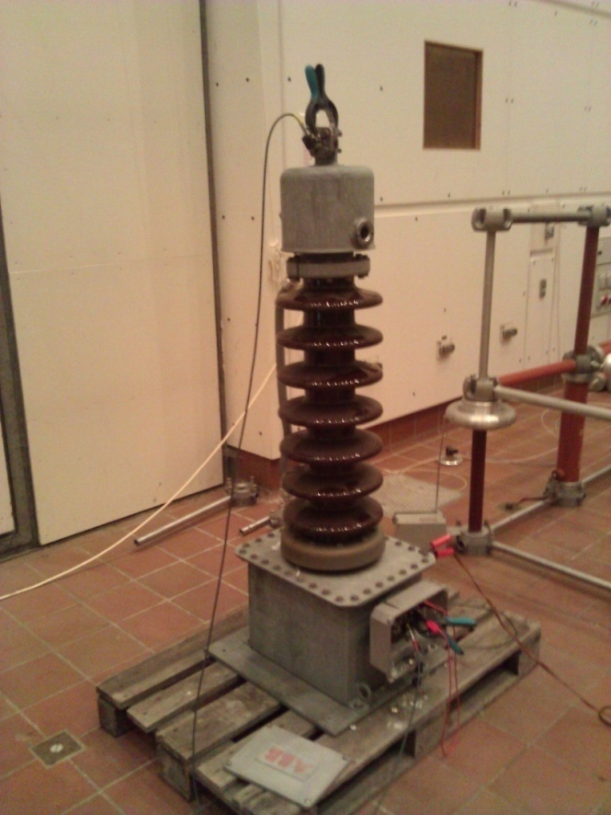
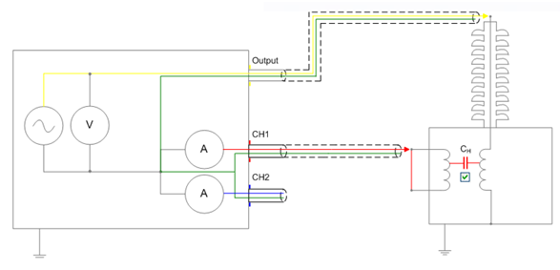
6.Dielectric Spectroscopy
DIRANA
ABB
EMF

Slide 27
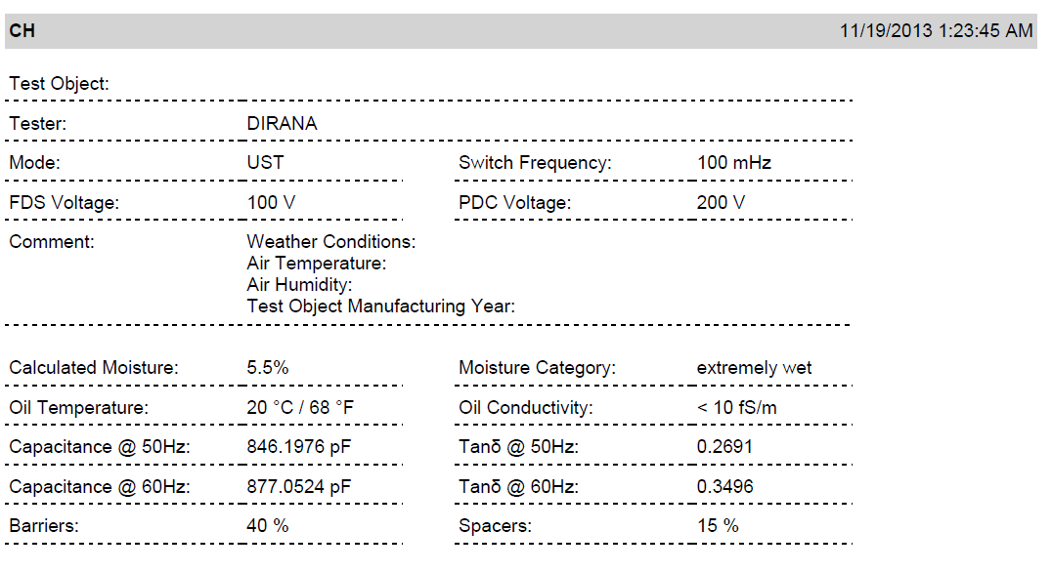
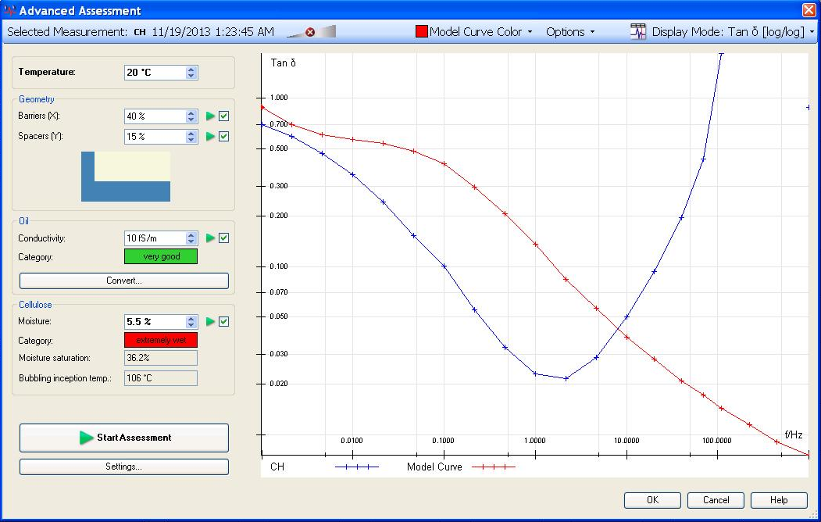
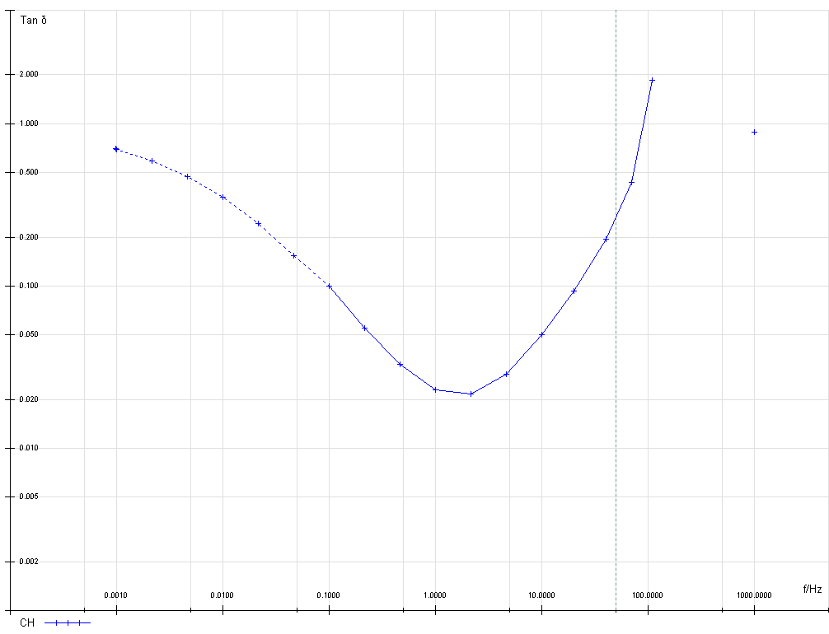
6.Dielectric Spectroscopy
Paper insulation
Insulation geometry
Oil
10 fS/m
Paper insulation
5.5%
* DIRANA software application

Slide 28
6.Dielectric Spectroscopy
ABB EMF Voltage transformer insulation:
Paper
Oil
Quartz sand
The test is designed for
Paper
Oil
The results are not relevant in this case!
Periodical measurements must be made!

